Slide 1
kinect
Vando Gusti Al hakim

Slide 2
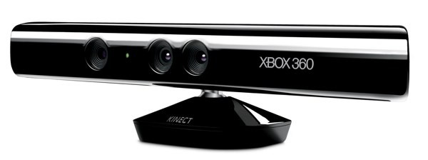
Kinect for Xbox 360 Sensor
Kinect, originally known by the code name Project Natal, is a motion sensing input device by Microsoft for the Xbox 360 video game console
Enable users to control and interact with the Xbox 360 without the need to touch a game controller
through a natural user interface (NUI) using gestures and spoken commands
Launched in North America on November 4, 2010
After selling a total of 8 million units in its first 60 days, the Kinect holds the Guinness World Record of being the "fastest selling consumer electronics device“!

Slide 3
Kinect for Windows SDK
A non-commercial Kinect software development kit (SDK) for Windows was released for Windows 7 on June 2011
The SDK includes Windows 7 compatible PC drivers for Kinect device
Provides Kinect capabilities to developers to build applications with C++, C#, or Visual Basic by using Microsoft Visual Studio 2010
Includes following features: Raw sensor streams, skeletal tracking, advanced audio capabilities, and sample code and documentation

Slide 4
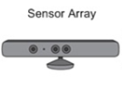

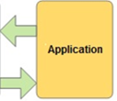
Natural User Interface (NUI) API
The NUI API is the core of the Kinect for Windows API
Support fundamental image and device management features, including the following:
Access to the Kinect sensors connected to the computer
Access to image and depth data streams from the Kinect image sensors
Delivery of a processed version of image and depth data to support skeletal tracking
Image Stream
Depth Stream
Audio Stream

Slide 5
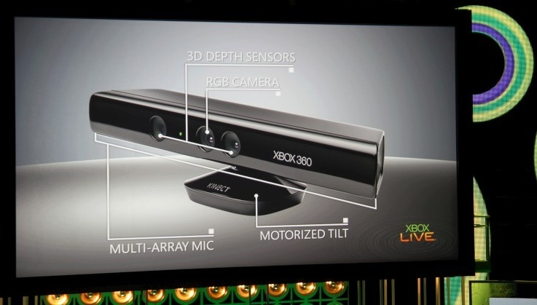
Hardware

Slide 6
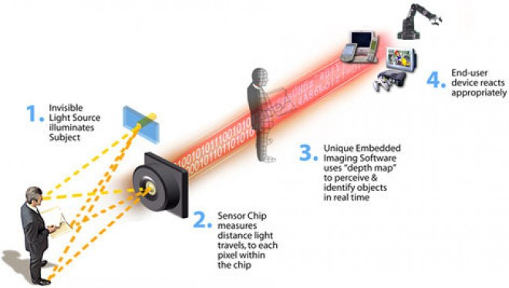
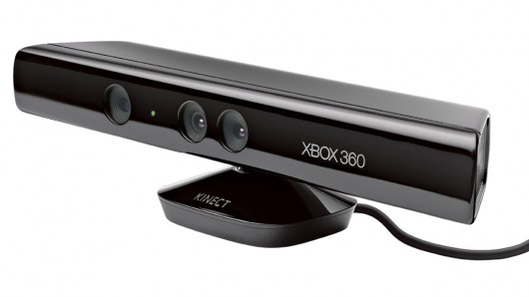
3D Depth Sensors
IR Projector
CMOS Sensor
Consists of IR projector and a CMOS sensor
IR beam bounces off subject and is captured by the CMOS sensor.
Sensor uses time to measure distance of objects

Slide 7
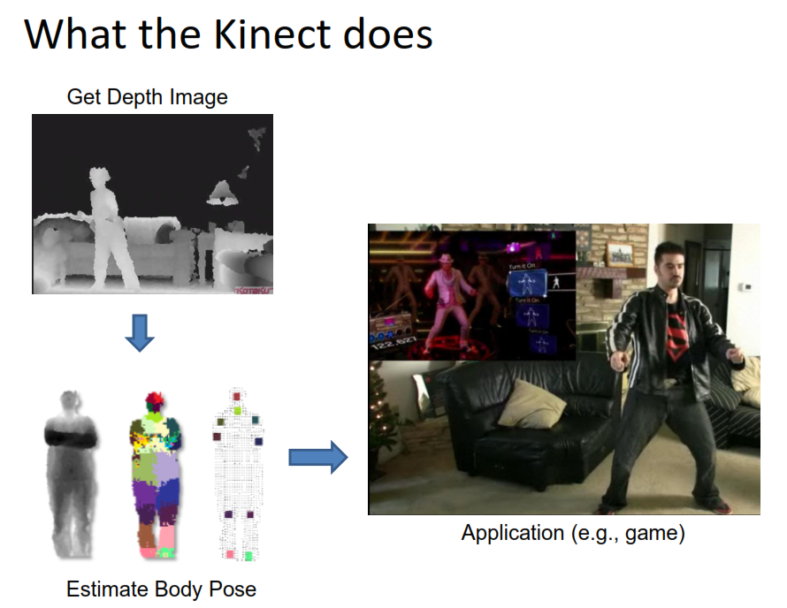

Slide 8
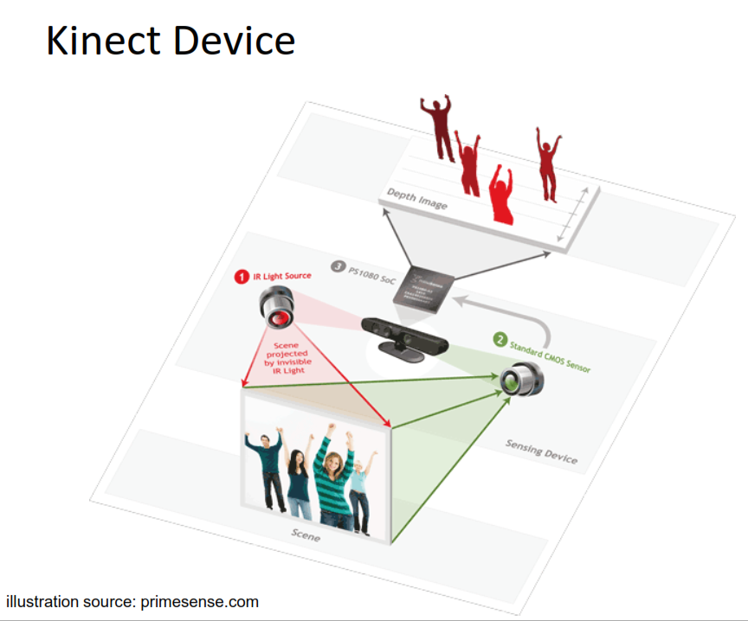

Slide 9
RGB Camera
Used for Facial Recognition and other features that require RGB readings.
640 x 480px at 30fps
11-bit depth, meaning 2048 colors
RGB Camera

Slide 10
Microphones
4 Microphones on the device
Supports single speaker voice recognition
16-bit audio sampled at 16kHz
Microphone Array

Slide 11
Processing
Natal housed a microprocessor to compute skeletal structure
All processing now has moved to the central Xbox 360 CPU

Slide 12
Kinect SDK
Camera Basics
Depth Basics
Skeletal Basics

Slide 13
Camera Basics
Polling vs. Eventing
polling async, eventing sync
allFramesReady event
Camera Generates byte array of pixels
Camera tilt
range -27 to 27 degrees
returns tilt based on mount angle

Slide 14

Depth Basics
Depth data for every pixel
distance (mm)
player (1-6)
Default & Near modes
near only provides a hip joint

Slide 15
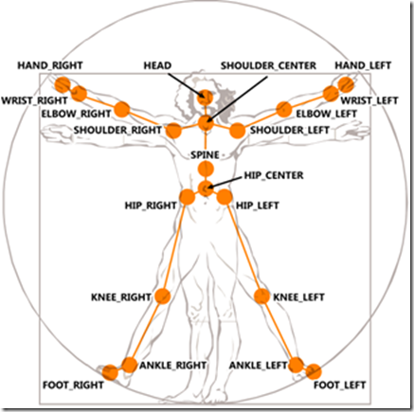
Skeletal Tracking
Tracks 1-2 players
xyz coordinates (z = dist. from camera)
State
tracked, not tracked, inferred
Smoothing
Scaling

